Slide 1
광양 141BRC 2D 충돌방지
Config 정리
20180817

Slide 2
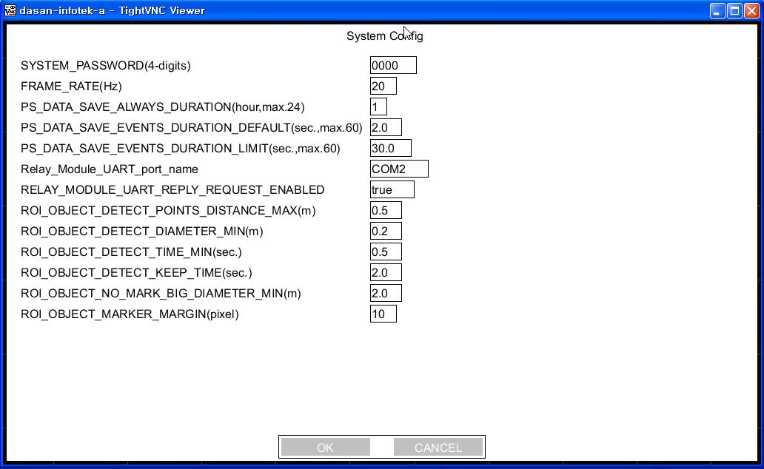
System Config

Slide 3
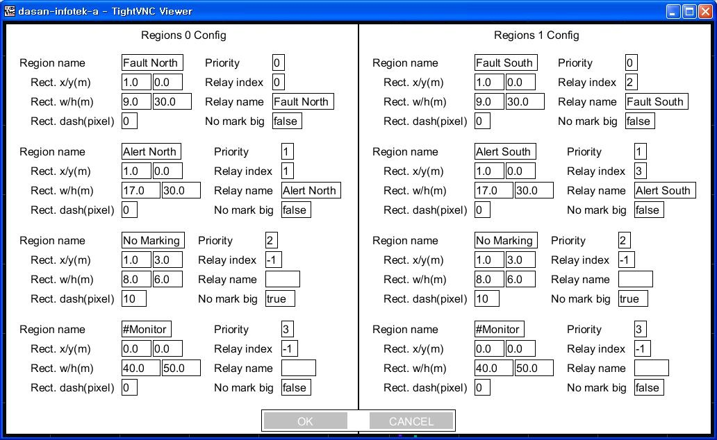
Regions Config

Slide 4
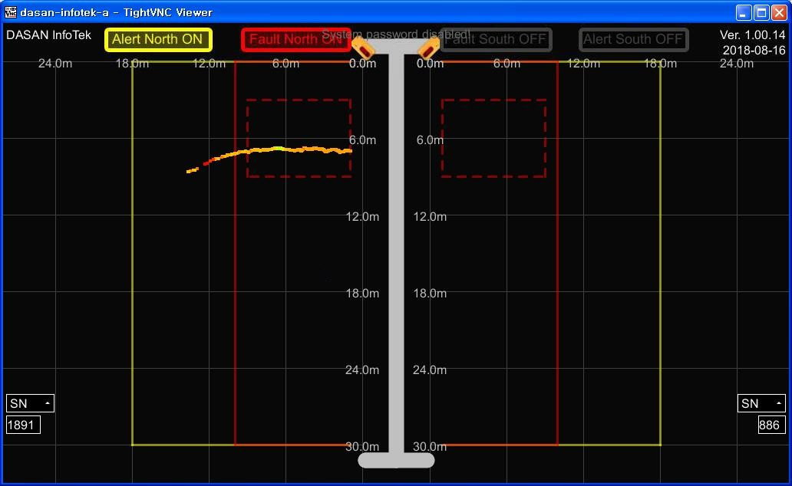
Interfaces Config

Slide 5
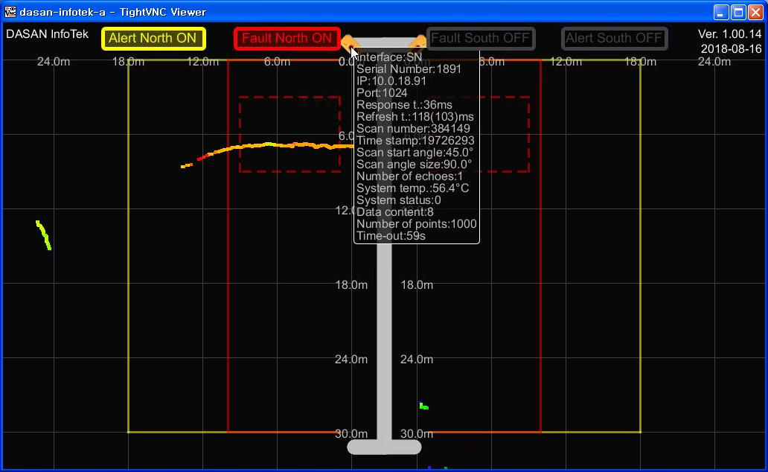
Angle Config – PS #0

Slide 6
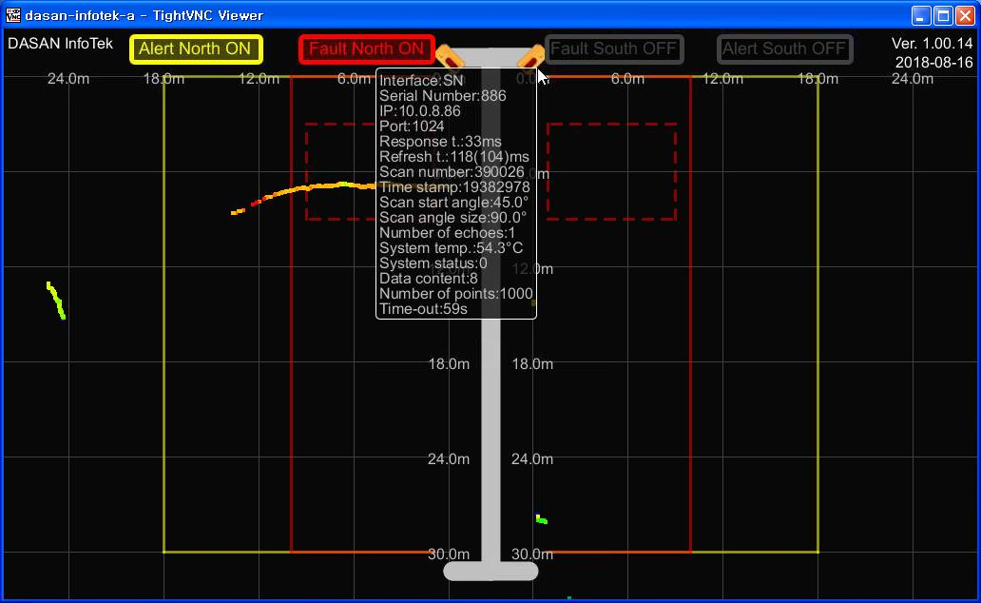
Angle Config – PS #1

Slide 7
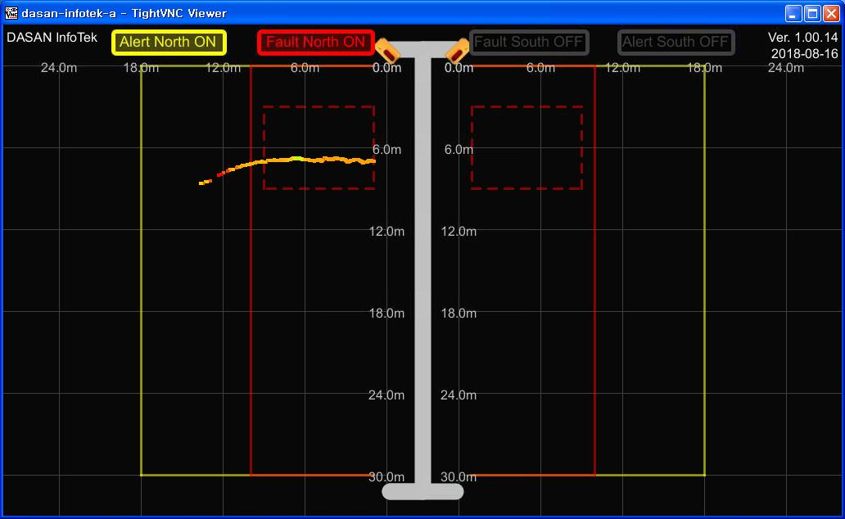
Run screenshot #1

Slide 8
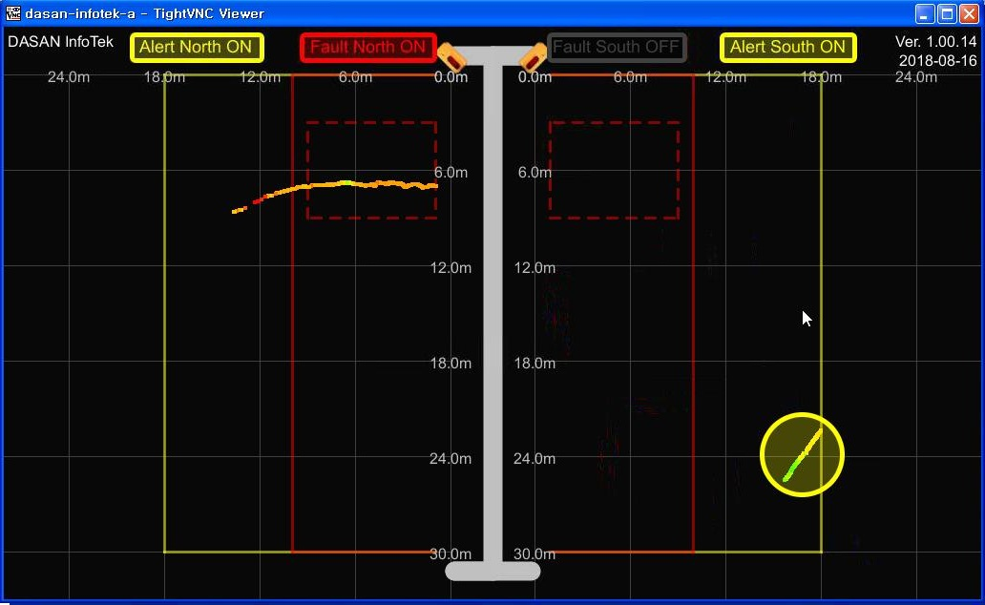
Run screenshot #2

Slide 9
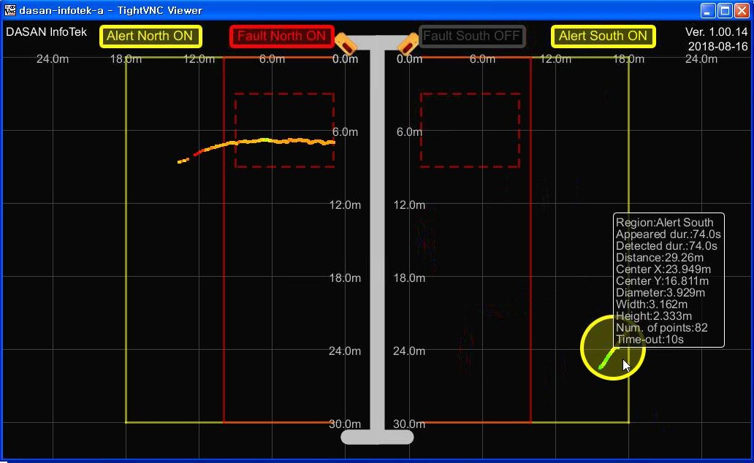
Run screenshot #3

Slide 10
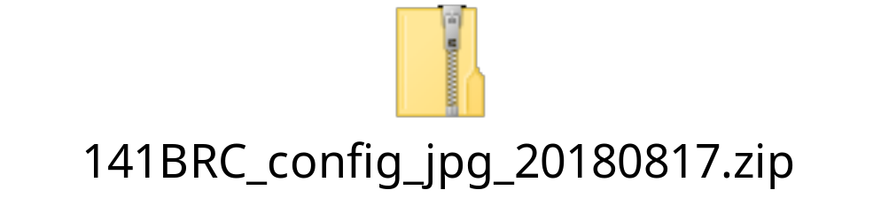
Config & jpg files

